Slide 1
Acceleration Due to Gravity

Slide 2
Acceleration Due to Gravity
Do all objects fall at the same rate?
Which item will hit the table first?

Slide 3
Dropping Things Activity
Drop the following objects from rest, from the same height, at the same time. Note when they reach the ground.
a) ball and flat piece of paper
b) ball and crumpled piece of paper
c) flat piece of paper laid on top of a book

Slide 4
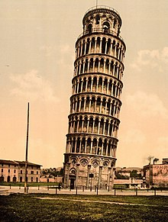
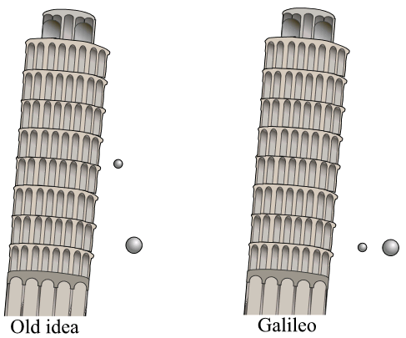
Galileo Galilei (1564 – 1642)
Piza Italy

Slide 5
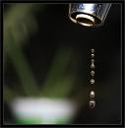
In a vacuum, all objects accelerate towards the earth at the same rate REGARDLESS of their mass (Galileo)
Acceleration due to gravity:
g = 9.81 m/s² [down]
This value varies slightly over the earth’s surface

Slide 6
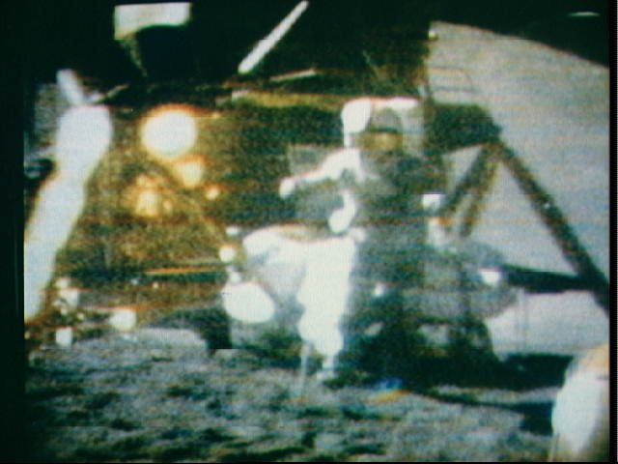
Feather and Hammer Experiment
Apollo 15, 1971

Slide 7
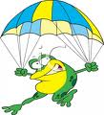
Effect of Air Resistance
Air resistance slows the rate at which objects fall
Effect depends upon the mass/surface area ratio
e.g. parachute surface area ↑
If given enough time to fall, air resistance will balance gravity and object will reach TERMINAL VELOCITY

Slide 8
Problem Analysis #0 :Famous Five Apply!
A ball dropped from a height of 100m.
How far does it fall in the first 1 second.
How far does it fall in the second second.
How far does it fall in the third second.

Slide 9
Problem Analysis #1 :Famous Five Apply!
A ball is thrown up in the air. It rises for 3.5 seconds until it comes to a stop and then begins to fall back down.
Draw a diagram showing the direction of velocity and acceleration.
Find the initial velocity.
Find the maximum distance it rose up into the air.
Ans: 34 m/s [up]; 6.0x 10 m [up]

Slide 10
Problem Analysis :Famous Five Apply!
A ball is thrown up in the air with an initial velocity of 6 m/s [Up]. Find:
The acceleration on the ball on its way up.
The acceleration on the ball on its way down.
The time it will take to go up and come back down.
The velocity of the ball when it comes back down.

Slide 11
Practice Questions:
Textbook Questions:
page 66 # 1,4,5,7,9,11, 14, 16,17
Famous Five Worksheet
Questions #1 to #14

